Slide 1

Chapter 3: Processes
Operating System Concepts – 9th Edition
Silberschatz, Galvin and Gagne ©2013

Slide 2
Chapter 3: Processes
Process Concept
Process Scheduling
Operations on Processes
Inter-process Communication (IPC)
Examples of IPC Systems
Communication in Client-Server Systems

Slide 3
Objectives
To introduce the notion of a process -- a program in
execution, which forms the basis of all computation
To describe the various features of processes, including scheduling, creation and termination, and communication
To explore interprocess communication using shared memory and message passing
To describe communication in client-server systems

Slide 4
Process Concept
Process – a program in execution; process execution must progress in sequential fashion
Program is passive entity stored on disk (executable file), process is active
Program becomes process when executable file loaded into memory
Execution of program started via GUI mouse clicks,
command line entry of its name, etc
One program can be several processes
Consider multiple users executing the same program

Slide 5

Process Structure
A process is more than the program code, which is sometimes known as the text section.
It also includes the current activity:
The value of the program counter
The contents of the processor's registers.
It also includes the process stack, which contains temporary
data (such as function parameters, return addresses, and local
variables)
It also includes the data section, which contains global
variables.
It may also include a heap, which is memory that is
dynamically allocated during process run time.

Slide 6
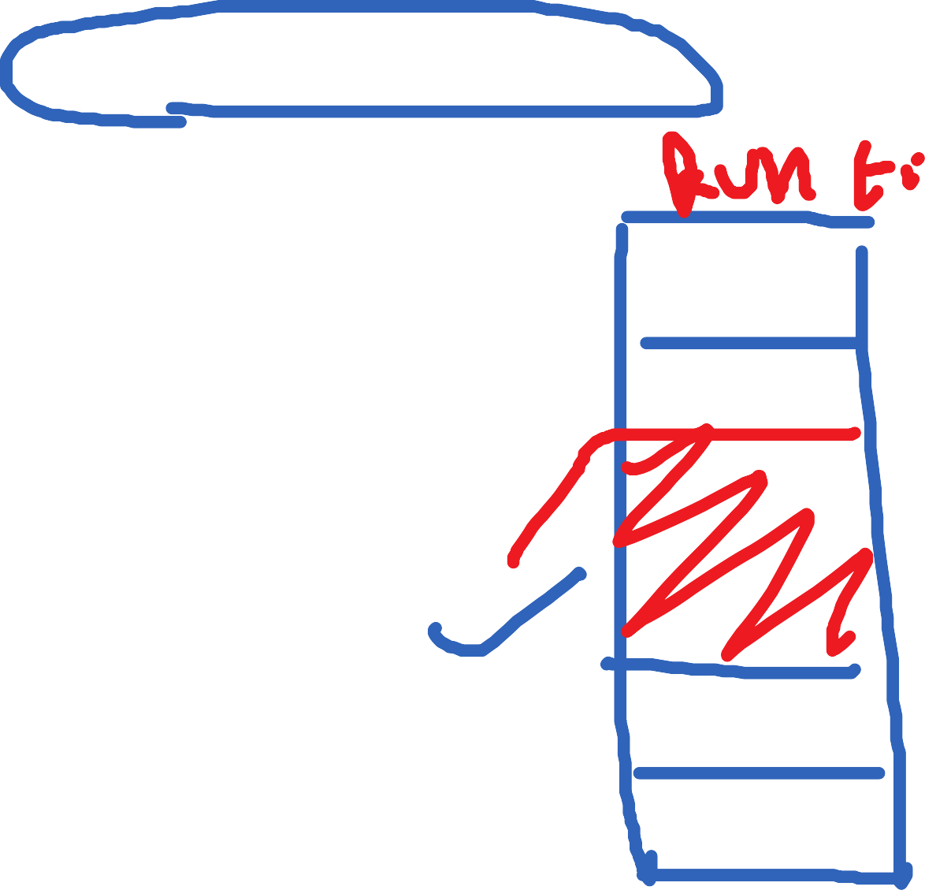
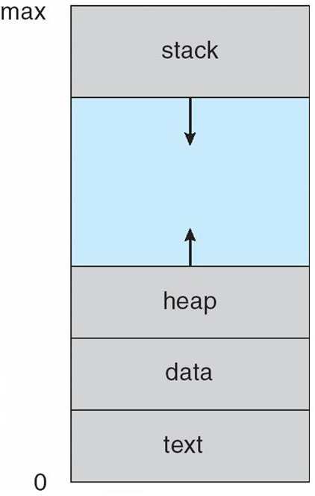
Process in Memory

Slide 7
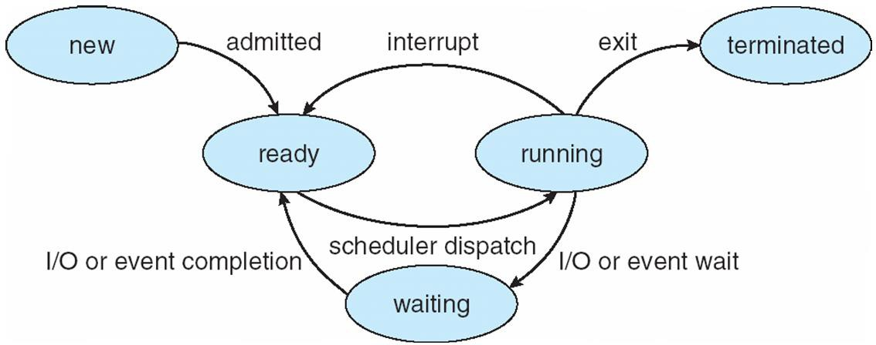
Process State
As a process executes, it changes state
new: The process is being created
running: Instructions are being executed
waiting: The process is waiting for some event to occur
ready: The process is waiting to be assigned to a processor
terminated: The process has finished execution
Diagram of Process State

Slide 8
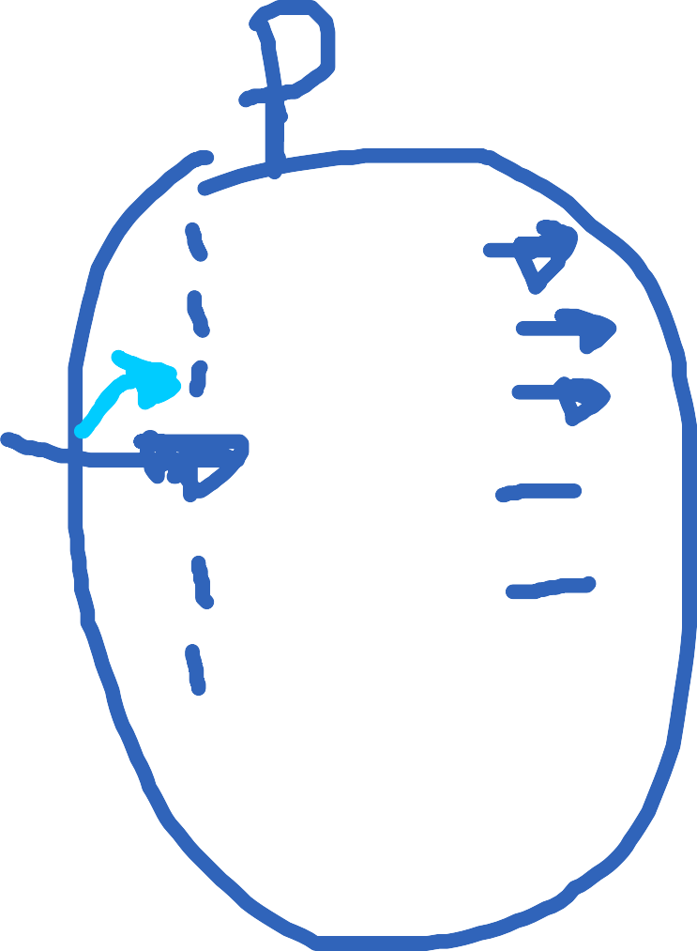
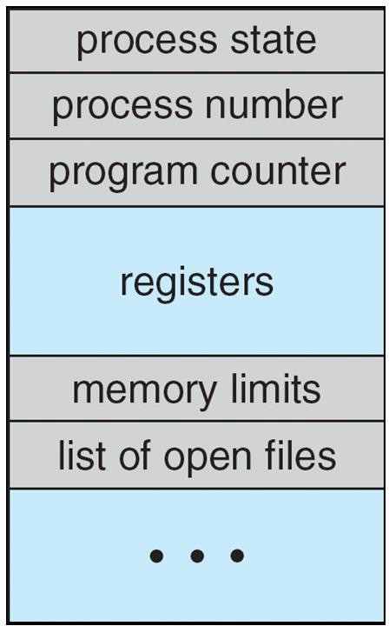
Process Control Block (PCB)
Information associated with each process
(also called task control block)
Process state – running, waiting, etc
Program counter – location of instruction to next execute
CPU registers – contents of all process-centric
registers
CPU scheduling information- priorities, scheduling queue pointers
Memory-management information – memory
allocated to the process
Accounting information – CPU used, clock time elapsed since start, time limits
I/O status information – I/O devices allocated to process, list of open files

Slide 9
Threads
So far, process has a single thread of execution
Consider having multiple program counters per process
Multiple locations can execute at once
 Multiple threads of control -> threads
Need storage for thread details, multiple program counters
in PCB
Covered in the next chapter

Slide 10
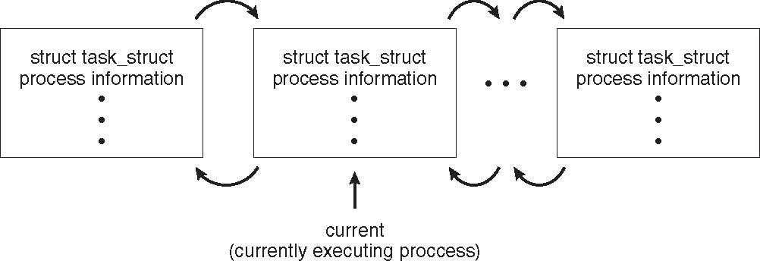
Process Representation in Linux
Represented by the C structure task_struct
pid t_pid; /* process identifier */
long state; /* state of the process */
unsigned int time_slice /* scheduling information */
struct task_struct *parent; /* this process’s parent */ struct list_head children; /* this process’s children */ struct files_struct *files; /* list of open files */ struct mm_struct *mm; /* address space of this process */

Slide 11


Process Scheduling
Maximize CPU use
Quickly switch processes onto CPU for time sharing
Process scheduler selects among available processes for next execution on CPU
Maintains scheduling queues of processes
Job queue – set of all processes in the system
Ready queue – set of all processes residing in main memory, ready and waiting to execute
Device queues – set of processes waiting for an I/O device
Processes migrate among the various queues

Slide 12
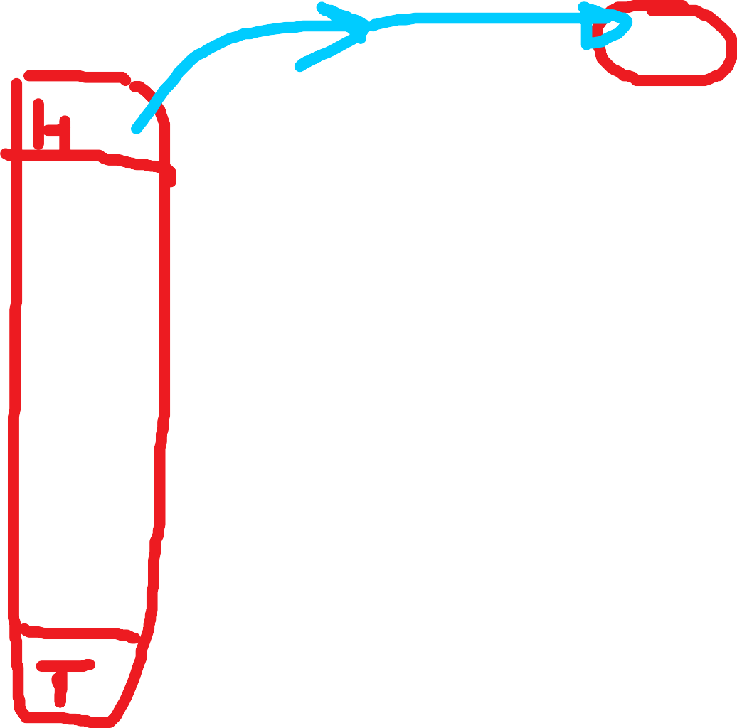
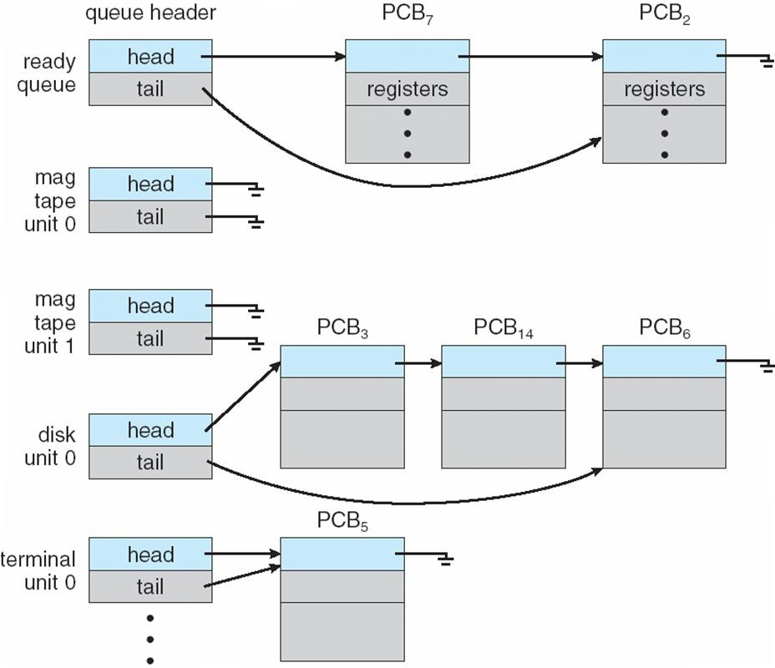
Ready Queue And Various I/O Device Queues

Slide 13
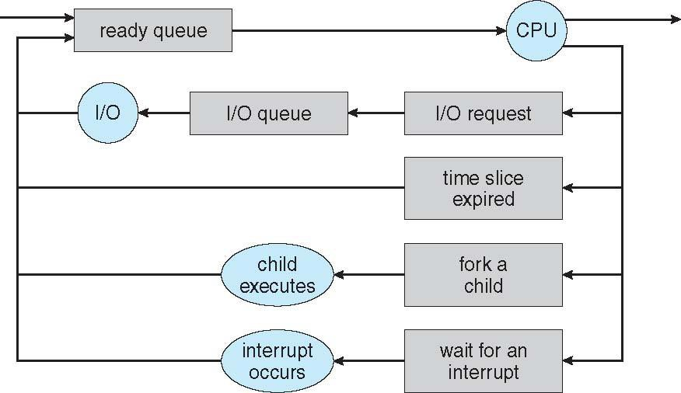
Representation of Process Scheduling
Queuing diagram represents queues, resources, flows

Slide 14


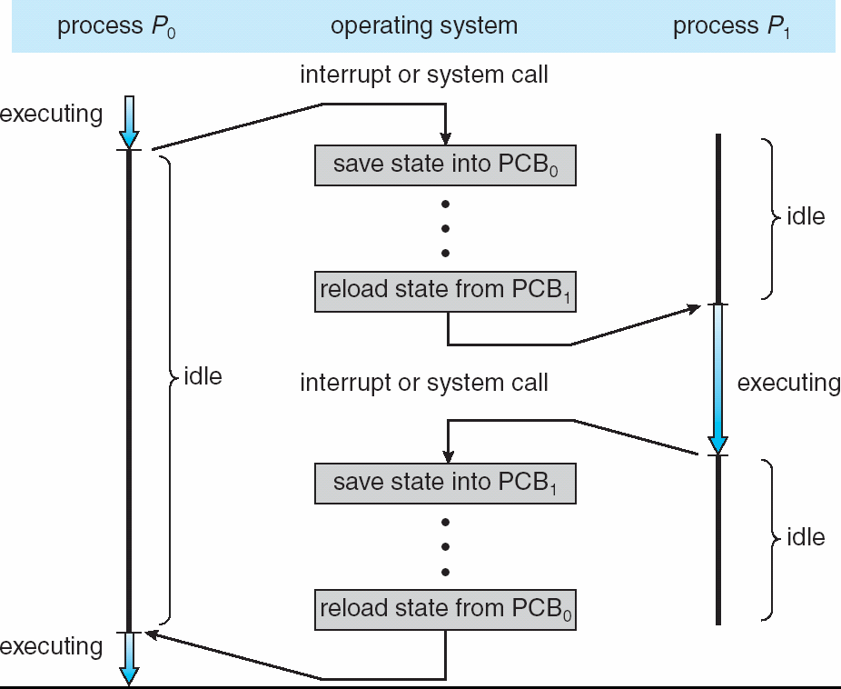

CPU Switch From Process to Process

Slide 15
Schedulers
Short-term scheduler (or CPU scheduler) – selects which process
should be executed next and allocates a CPU
Sometimes the only scheduler in a system
Short-term scheduler is invoked frequently (milliseconds) ⇒ (must be fast)
Long-term scheduler (or job scheduler) – selects which processes
should be brought into the ready queue
Long-term scheduler is invoked infrequently (seconds, minutes) ⇒
(may be slow)
The long-term scheduler controls the degree of multiprogramming
Processes can be described as either:
I/O-bound process – spends more time doing I/O than
computations, many short CPU bursts
CPU-bound process – spends more time doing computations; few very long CPU bursts
Long-term scheduler strives for good process mix

Slide 16
Multitasking in Mobile Systems
Some mobile systems (e.g., early version of iOS) allow only one
process to run, others suspended
Starting with iOS 4, it provides for a
Single foreground process – controlled via user interface
Multiple background processes – in memory, running, but not on the display, and with limits
Limits include single, short task, receiving notification of events, specific long-running tasks like audio playback
Android runs foreground and background, with fewer limits
Background process uses a service to perform tasks
Service can keep running even if background process is
suspended
Service has no user interface, small memory use

Slide 17

Context Switch
When CPU switches to another process, the system must save the state of the old process and load the saved state for the new process via a context switch
Context of a process represented in the PCB
Context-switch time is pure overhead; the system does no useful work while switching
The more complex the OS and the PCB ➔ the longer the context switch
Time dependent on hardware support
Some hardware provides multiple sets of registers per
CPU ➔ multiple contexts loaded at once

Slide 18
Operations on Processes
System must provide mechanisms for:
process creation,
process termination,
and so on as detailed next

Slide 19
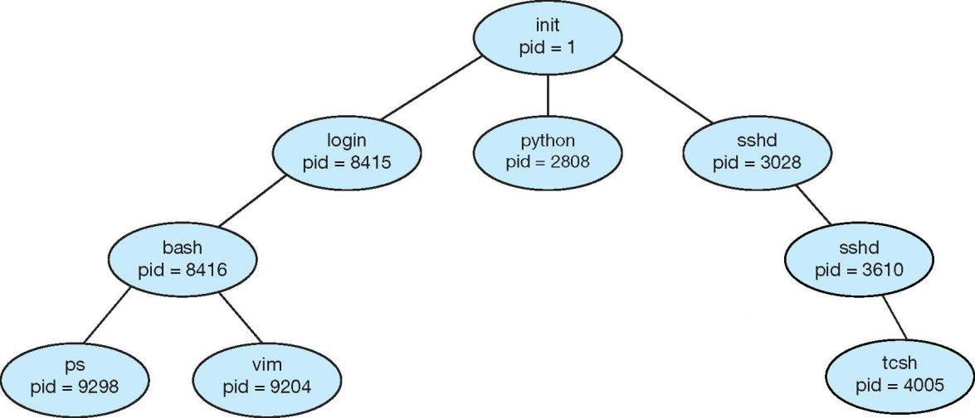
Process Creation
A process may create other processes.
Parent process create children processes, which, in turn create other processes, forming a tree of processes
Generally, a process is identified and managed via a
process identifier (pid)
A Tree of Processes in UNIX

Slide 20
Process Creation (Cont.)
Resource sharing among parents and children options
Parent and children share all resources
Children share subset of parent’s resources
Parent and child share no resources
Execution options
Parent and children execu te concurrently
Parent waits until children terminate

Slide 21
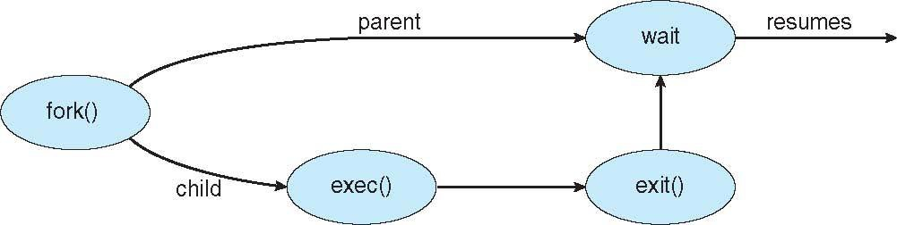
Process Creation (Cont.)
Address space
A child is a duplicate of the parent address space.
A child loads a program into the address space.
UNIX examples
fork() system call creates new process
exec() system call used after a fork()replaces
the process’ memory space with a new program

Slide 22
C program to create a separate process in UNIX
int main()
{
pit.t pid;
/*fork a child process */
pid = fork();
if (pid < 0) { /* error occurred */ fprintf(stderr, “Fork Failed”); return 1;
}
else if (pid == 0) { /*child process */
execlp(“/bin/ls”,”ls”,NULL);
}
else { /* parent process */
/* parent will wait for the child to complete */ wait(NULL);
printf(“Child Complete”);
}
return 0;
}

Slide 23
C Program Forking Separate Process
The C program illustrates how to create a new process UNIX.
After fork() there are two different processes running copies of the same program. The only difference is that the value of pid for the child process is zero, while that for the parent is an integer value greater than zero
The child process inherits privileges and scheduling attributes from the parent, as well certain resources, such as open files.
The child process then overlays its address space with the UNIX command “ls” (used to get a directory listing) using the execlp() (a version of the exec() system call).
The parent waits for the child process to complete with the wait() system call.
When the child process completes the parent process resumes from the call to wait(), where it completes using the exit() system call.

Slide 24
Creating a Separate Process via Windows API
int main(VOID)
{
STARTUPINFO si; PROCESS_INFORMATION pi;
/* allocate memory */ ZeroMemory(&si, sizeof(si)); si.cb = sizeof(si); ZeroMemory(&pi, sizeof(pi));
/* create child process */
if (!CreateProcess(NULL, /* use command line */ “C:\\WINDOWS\\system32\\mspaint.exe”,/* command */ NULL, /* don’t inherit process handle */
NULL, /* don’t inherit threat handle */ FALSE, /* disable handle inheritance */ 0, /* no creation flags */
NULL, /* use parent’s environment block */ NULL, /* use parent’s existing directory */ &si,
&pi))
{

Slide 25
Creating a Separate Process via Windows API (Cont.)
{
fprintf{stderr, “Create Process Failed”};
return -1;
}
/* parent will wait for the child to complete */ WaitForSingleObject(pi.hProcess, INFINITE); printf(“Child Complete”);
/* close handles */ CloseHandle(pi.hProcess); CloseHandle(pi.hThread);
}

Slide 26
Process Termination
A process terminates when it finishes executing its final statement and it asks the operating system to delete it by
using the exit()
system call.
At that point, the process may return a status value (typically an integer) to its parent process (via the wait() system call.
All the resources of the process are deallocated by the operating system.
A parent may terminate the execution of children processes
using the abort() system call. Some reasons for doing so:
Child has exceeded allocated resources
Task assigned to child is no longer required
The parent is exiting and the operating systems does not
allow a child to continue if its parent terminates

Slide 27
Process Termination (Cont.)
Some operating systems do not allow a child process to exists if its parent has terminated. If a process terminates, then all its children must also be terminated.
cascading termination. All children, grandchildren, etc. are terminated.
The termination is initiated by the operating system.
The parent process may wait for termination of a child process by using the wait()system call. The call returns status information and the pid of the terminated process
pid = wait(&status);
If no parent waiting (did not invoke wait()) process is zombie
If parent terminated without invoking wait, process is orphan

Slide 28


Interprocess Communication
Processes within a system may be independent or
cooperating
Cooperating processes can affect or be affected by other processes, including sharing data
Independent processes cannot affect other processes
Reasons for having cooperating processes:
Information sharing
Computation speedup (multiple processes running in
parallel)
Modularity
Convenience
Cooperating processes need interposes communication (IPC)

Slide 29

Synchronization
Cooperating processes that access shared data need to
synchronize their actions to ensure data consistency
Maintaining data consistency requ ire s mechanisms to ensure
the orderly execution of cooperating processes
Illustration of the problem – The producer-Consumer problem
Producer process produces information that is consumed by a Consumer process.
The information is passed from the Producer to the Consumer via a buffer.
Two types of buffers can be used:
unbounded-buffer places no practical limit on the size
of the buffer
bounded-buffer assumes that a fixed buffer size

Slide 30

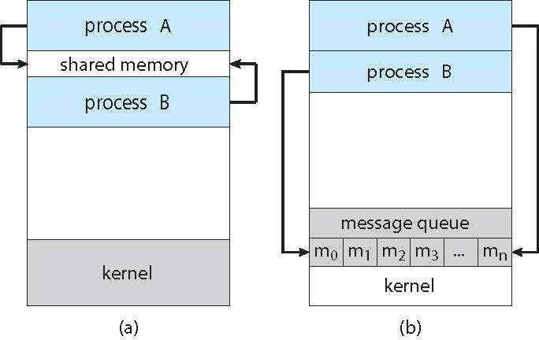
Communications Models
Two models of IPC
Shared memory
Message passing

Slide 31
Shared Memory Systems
An area of memory shared among the processes that wish to communicate
The communication is under the control of the users
processes not the operating system.
Major issues is to provide mechanism that will allow the user processes to synchronize their actions when they access shared memory.
We illustrate synchronization in a shared-memory environment using the producer-consumer paradigm with bounded buffers.

Slide 32
Bounded-Buffer Solution
Shared data
#define BUFFER_SIZE 10 typedef struct {
. . .
} item;
item buffer[BUFFER_SIZE];
int in = 0;
int out = 0;
Solution presented in the next two slides is correct, but only 9 out of 10 buffer elements can be used

Slide 33
Bounded-Buffer – Producer
item next_produced;
while (true) {
/* produce an item in next produced */ while (((in + 1) % BUFFER_SIZE) == out)
; /* do nothing */ buffer[in] = next_produced; in = (in + 1) % BUFFER_SIZE;
}

Slide 34
Bounded Buffer – Consumer
item next_consumed; while (true) {
while (in == out)
; /* do nothing */ next_consumed = buffer[out];
out = (out + 1) % BUFFER_SIZE;
/* consume the item in next consumed */
}

Slide 35
Message Passing Systems
Mechanism for processes to communicate and to synchronize their actions
Without resorting to shared variables
IPC facility provides two operations:
send(message)
receive(message)
The message size is either fixed or variable

Slide 36
Message Passing (Cont.)
If processes P and Q wish to communicate, they need to:
Establish a communication link between them
Exchange messages via send/receive
Implementation issues:
How are links established?
Can a link be associated with more than two processes?
How many links can there be between every pair of communicating processes?
What is the capacity of a link?
Is the size of a message that the link can accommodate fixed or variable?
Is a link unidirectional or bi-directional?

Slide 37
Implementation of Communication Link
Physical:
Shared memory
Hardware bus
Network
Logical:
Direct or indirect
Synchronous or asynchronous
Automatic or explicit buffering

Slide 38
Direct Communication
Processes must name each other explicitly:
send (P, message) – send a message to process P
receive(Q, message) – receive a message from process Q
Properties of communication link
Links are established automatically
A link is associated with exactly one pair of communicating processes
Between each pair there exists exactly one link
The link may be unidirectional, but is usually bi-directional

Slide 39
Indirect Communication
Messages are directed and received from mailboxes (also
referred to as ports)
Each mailbox has a unique id
Processes can communicate only if they share a mailbox
Operations
create a new mailbox (port)
send and receive messages through mailbox
delete a mailbox
Primitives are defined as:
send(A, message) – send a message to mailbox A
receive(A, message) – receive a message from mailbox A

Slide 40
Indirect Communication (Cont.)
Properties of communication link
Link established only if processes share a common
mailbox
A link may be associated with many processes
Each pair of processes may share several communication links
Link may be unidirectional or bi-directional

Slide 41
Indirect Communication Issues
Mailbox sharing
P₁, P₂, and P₃ share mailbox A
P₁, sends; P₂ and P₃ receive
Who gets the message?
Solutions
Allow a link to be associated with at most two processes
Allow only one process at a time to execute a receive
operation
Allow the system to select arbitrarily the receiver. Sender is notified who the receiver was.

Slide 42




Blocking and Non-blocking schemes
Message passing may be either blocking or non-blocking
Blocking is considered synchronous
Blocking send -- the sender is blocked until the message is
received
Blocking receive -- the receiver is blocked until a message is available
Non-blocking is considered asynchronous
Non-blocking send -- the sender sends the message and continue
Non-blocking receive -- the receiver receives: A valid message, or
Null message
Different combinations possible
If both send and receive are blocking, we have a rendezvous

Slide 43
Buffering
Whether communication is direct or indirect, messages exchanged by communicating processes reside in a temporary queue.
Such queues can be implemented in three ways:
Zero capacity – no messages are queued on a link. Sender must wait for receiver (rendezvous)
Bounded capacity – finite length of n messages Sender
must wait if link full
Unbounded capacity – infinite length Sender never waits

Slide 44
Producer-Consumer with Rendezvous
Producer-consumer synchronization becomes trivial with
rendezvous (blocking send and receive)
message next_produced; while (true) {
/* produce an item in next produced */
send(next_produced);
}
message next_consumed; while (true) {
receive(next_consumed);
/* consume the item in next consumed */
}

Slide 45
Example of IPC Systems
There are four different IPC systems.
POSIX API for shared memory
Mach operating system, which uses message passing
Windows IPC, which uses shared memory as a mechanism for providing certain types of message passing.
Pipes, one of the earliest IPC mechanisms on UNIX systems.

Slide 46
POSIX
POSIX

Slide 47
Mach
Mach communication is message based
Even system calls are messages
Each task gets two mailboxes at creation- Kernel and Notify
Only three system calls needed for message transfer
msg_send(), msg_receive(), msg_rpc()
Mailboxes needed for commuication, created via
port_allocate()
Send and receive are flexible, for example four options if mailbox full:
Wait indefinitely
Wait at most n milliseconds
Return immediately
Temporarily cache a message

Slide 48
Windows
Message-passing centric via advanced local procedure call
(LPC) facility
Only works between processes on the same system
Uses ports (like mailboxes) to establish and maintain communication channels
Communication works as follows:
The client opens a handle (an abstract reference to a resource) to the subsystem’s connection port object.
The client sends a connection request.
The server creates a private communication port and returns the handle to the client.
The client and server use the corresponding port handle to send messages or callbacks and to listen for replies.

Slide 49
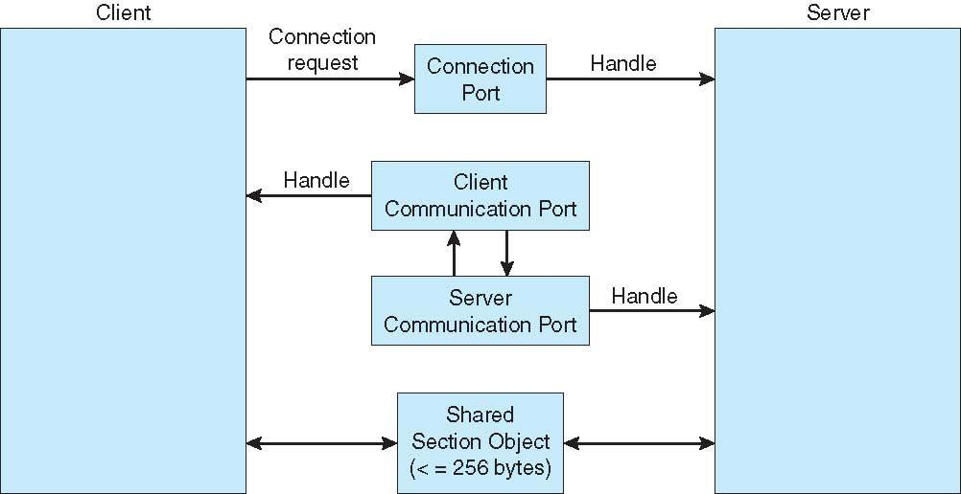
Local Procedure Calls in Windows

Slide 50
Pipes
Acts as a conduit allowing two processes to communicate
Issues:
Is communication unidirectional or bidirectional?
In the case of two-way communication, is it half or full- duplex?
Must there exist a relationship (i.e., parent-child) between the communicating processes?
Can the pipes be used over a network?
Ordinary pipes – cannot be accessed from outside the process that created it. Typically, a parent process creates a pipe and uses it to communicate with a child process that it created.
Named pipes – can be accessed without a parent-child relationship.

Slide 51


Ordinary Pipes
Ordinary Pipes allow two process to communication in standard producer-consumer style
Producer writes to one end (the write-end of the pipe) Consumer reads from the other end (the read-end of the pipe)
Ordinary pipes are unidirectional, allowing only one-way communication.
If two-way communication is required, two pipes must be used, with each pipe sending data in a different direction.
Require parent-child relationship between communicating processes

Slide 52
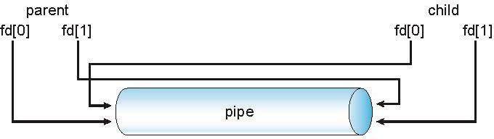
Ordinary Pipes
On UNIX systems, ordinary pipes are constructed using the function
pipe (int fd[])
This function creates a pipe that is accessed through the int fd[]
file descriptors:
fd[0] is the read-end of the pipe
fd[1]} is the write-end of the pipe
UNIX treats a pipe as a special type of file. Thus, pipes can be accessed using ordinary read() and write() system calls.

Slide 53
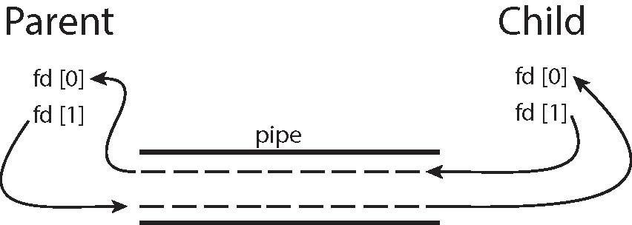
Figure Pipe

Slide 54
Named Pipes
Named Pipes are more powerful than ordinary pipes
Communication is bidirectional
No parent-child relationship is necessary between the communicating processes
Several processes can use the named pipe for communication
Provided on both UNIX and Windows systems

Slide 55
Communications in Client-Server Systems
Sockets
Remote Procedure Calls
Remote Method Invocation (Java)

Slide 56
Sockets
A socket is defined as an endpoint for communication
Concatenation of IP address and port – a number included at start of message packet to differentiate network services on a host
The socket 161.25.19.8:1625 refers to port 1625 on host
161.25.19.8
Communication consists between a pair of sockets
All ports below 1024 are well known, used for standard services
Special IP address 127.0.0.1 (loopback) is used to refer to system on which process is running. That is, when a computer refers to address 127.0.0.1, it is referring to itself.

Slide 57
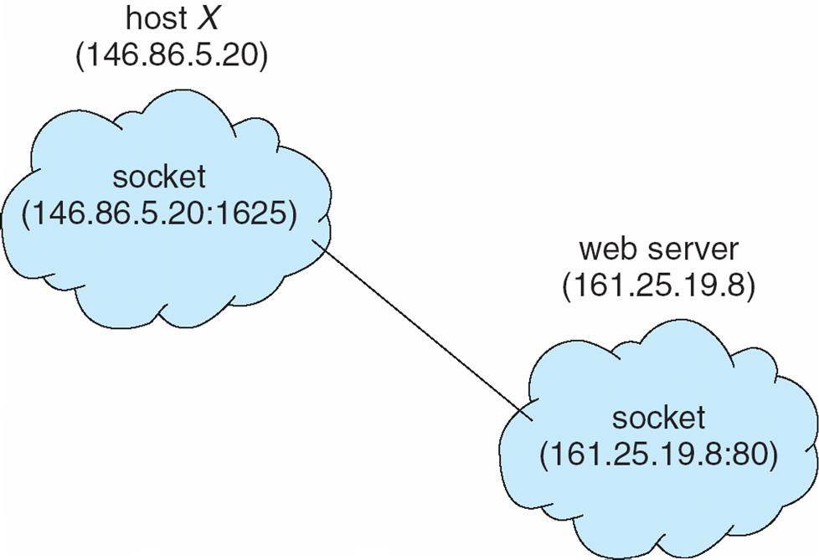
Socket Communication

Slide 58
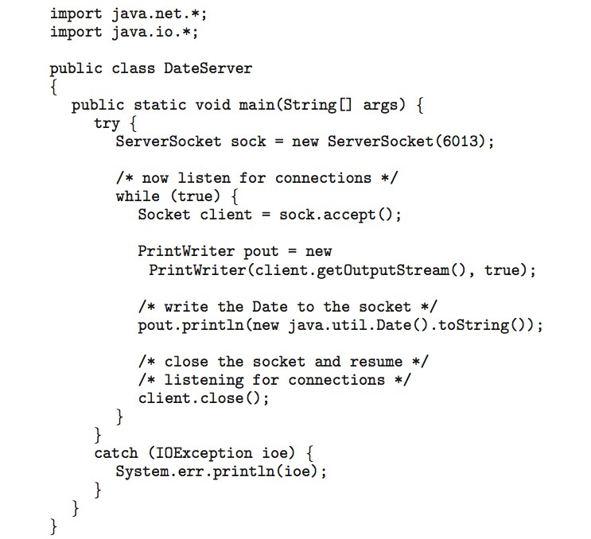
Sockets in Java
Three types of sockets
Connection-oriented
(TCP)
Connectionless (UDP)
MulticastSocket class – data can be sent to multiple recipients
Consider this “Date” server:

Slide 59
Remote Procedure Calls
Remote procedure call (RPC) abstracts procedure calls between processes on networked systems
Again uses ports for service differentiation
Stubs – client-side proxy for the actual procedure on the
server
The client-side stub locates the server and marshalls the parameters (marshalling involves packaging the parameters into a form that can be transmitted over a network).
The server-side stub receives this message, unpacks the marshalled parameters, and performs the procedure on the server
On Windows, stub code compile from specification written in
Microsoft Interface Definition Language (MIDL)

Slide 60
Remote Procedure Calls (Cont.)
Data representation handled via External Data Representation
(XDL) format to account for different architectures.
Must be dealt with concerns differences in data representation on
the client and server machines.
Consider the representation of 32-bit integers.
Big-endian. Store the most significant byte first
Little-endian. Store the least significant byte first.
Big-endian is the most common format in data networking . It is also referred to as network byte order.
Remote communication has more failure scenarios than local
Messages can be delivered exactly once rather than at most
once
OS typically provides a rendezvous (or matchmaker) service to connect client and server

Slide 61
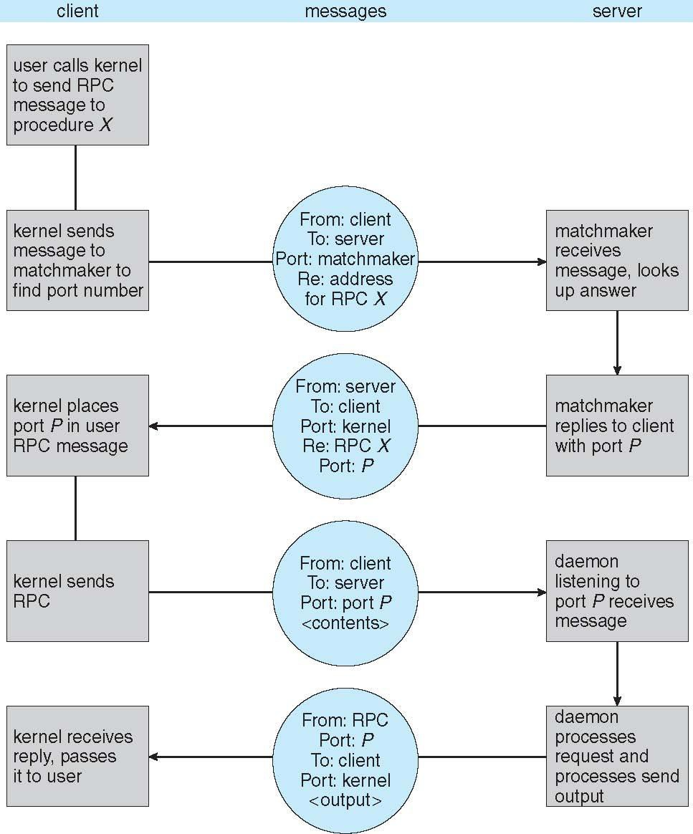
Execution of RPC

Slide 62
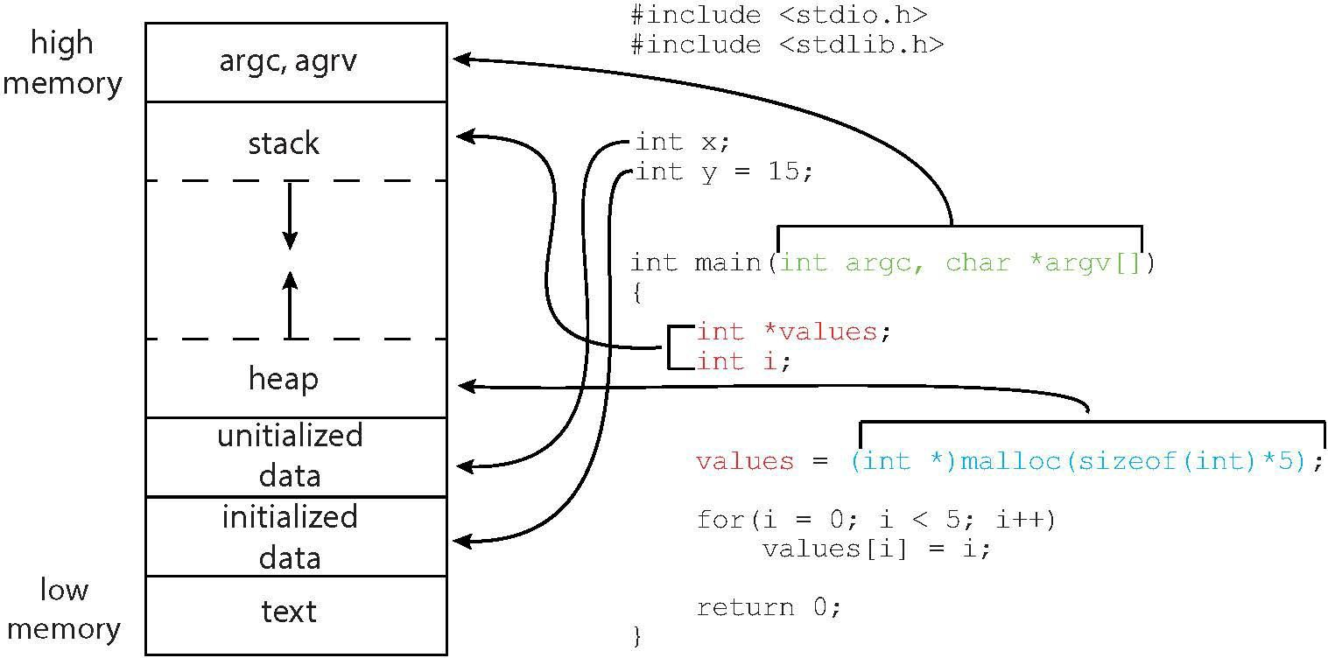
Figure Memory Layout

Slide 63

Multiprocess Architecture – Chrome Browser
Many web browsers ran as single process (some still do)
If one web site causes trouble, entire browser can hang or crash
Google Chrome Browser is multiprocess with 3 different types of processes:
Browser process manages user interface, disk and network I/O
Renderer process renders web pages, deals with HTML, Javascript. A new renderer created for each website opened
 Runs in sandbox restricting disk and network I/O, minimizing
effect of security exploits
Plug-in process for each type of plug-in

Slide 64
End of Chapter 3

Slide 65
Process Concept
An operating system executes a variety of programs:
Batch system – jobs
Time-shared systems – user programs or tasks
Textbook uses the terms job and process almost interchangeably
Process – a program in execution; process execution must
progress in sequential fashion
Multiple parts
The program code, also called text section
Current activity including program counter, processor
registers
Stack containing temporary data
 Function parameters, return addresses, local variables
Data section containing global variables
Heap containing memory dynamically allocated during run time

Slide 66
Process Concept
Process – a program in execution; process execution must progress in sequential fashion
Multiple parts
The program code, also called text section
Current activity including program counter, processor
registers
Stack containing temporary data
 Function parameters, return addresses, local variables
Data section containing global variables
Heap containing memory dynamically allocated during run time

Slide 67
Diagram of Process State

Slide 68

A Tree of Processes in UNIX

Slide 69
Synchronization
Cooperating process must synchronize their actions
To illustrate the concept of cooperating processes, we will consider the producer-consumer problem, which is a common paradigm for cooperating processes.
A producer process produces information that is consumed by a consumer process.
For example, a compiler may produce assembly code that is consumed by an assembler. The assembler, in turn, may produce object modules that are consumed by the loader.
The producer-consumer problem also provides a useful metaphor for the client-server paradigm. We generally think of a server as a producer and a client as a consumer. For example, a web server produces (that is, provides) web content such as HTML files and images, which are consumed (that is, read) by the client web browser requesting the resource.

Slide 70
Synchronization
Cooperating processes Concurrent access to shared data may result in data inconsistency
Maintaining data consistency requires mechanisms to ensure the orderly execution of cooperating processes
Illustration of the problem – The producer-Consumer problem
Producer process produces information that is consumed by a Consumer process.
The information is passed from the Producer to the Consumer via a buffer.
Two types of buffers can be used:
unbounded-buffer places no practical limit on the size
of the buffer
bounded-buffer assumes that a fixed buffer size

Slide 71
Synchronization
Cooperating processes Concurrent access to shared data may result in data inconsistency
Maintaining data consistency requires mechanisms to ensure the orderly execution of cooperating processes
Illustration of the problem – The producer-Consumer problem
Producer process produces information that is consumed by a Consumer process.
The information is passed from the Producer to the Consumer via a buffer.
Two types of buffers can be used:
unbounded-buffer places no practical limit on the size
of the buffer
bounded-buffer assumes that a fixed buffer size
Operating System Concepts – 9th Edition
3.71
Silberschatz, Galvin and Gagne ©2013

Slide 72
Synchronization
Concurrent access to shared data may result in data inconsistency
Maintaining data consistency requires mechanisms to ensure the orderly execution of cooperating processes
Illustration of the problem – The producer-Consumer problem
Producer process produces information that is consumed by a Consumer process.
The information is passed from the Producer to the Consumer via a buffer.
Two types of buffers can be used:
unbounded-buffer places no practical limit on the size
of the buffer
bounded-buffer assumes that a fixed buffer size

Slide 73
Bounded-Buffer Solution – Shared Memory
Shared data
#define BUFFER_SIZE 10 typedef struct {
. . .
} item;
item buffer[BUFFER_SIZE];
int in = 0;
int out = 0;
Solution presented in the next two slides is correct, but only 9 out of 10 buffer elements can be used

Slide 74
Bounded-Buffer – Producer
item next_produced;
while (true) {
/* produce an item in next produced */ while (((in + 1) % BUFFER_SIZE) == out)
; /* do nothing */ buffer[in] = next_produced; in = (in + 1) % BUFFER_SIZE;
}

Slide 75
Bounded Buffer – Consumer
item next_consumed; while (true) {
while (in == out)
; /* do nothing */ next_consumed = buffer[out];
out = (out + 1) % BUFFER_SIZE;
/* consume the item in next consumed */
}

Slide 76
Producer-Consumer with Rendezvous
Producer-consumer synchronization becomes trivial with
rendezvous (blocking send and receive)
message next_produced; while (true) {
/* produce an item in next produced */
send(next_produced);
}
message next_consumed; while (true) {
receive(next_consumed);
/* consume the item in next consumed */
}

Slide 77
Examples of IPC Systems - Mach
Mach communication is message based
Even system calls are messages
Each task gets two mailboxes at creation- Kernel and Notify
Only three system calls needed for message transfer
msg_send(), msg_receive(), msg_rpc()
Mailboxes needed for commuication, created via
port_allocate()
Send and receive are flexible, for example four options if mailbox full:
Wait indefinitely
Wait at most n milliseconds
Return immediately
Temporarily cache a message

Slide 78
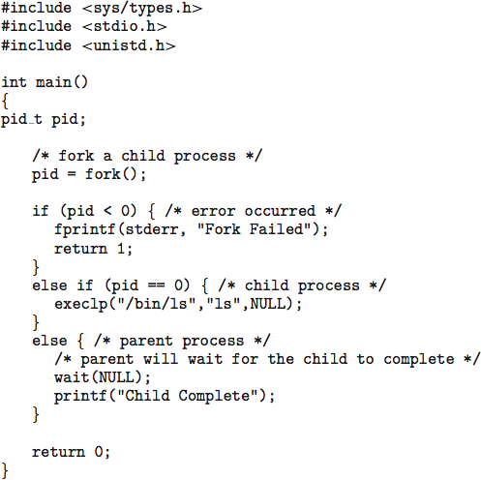
C program to create a separate process in UNIX

Slide 79
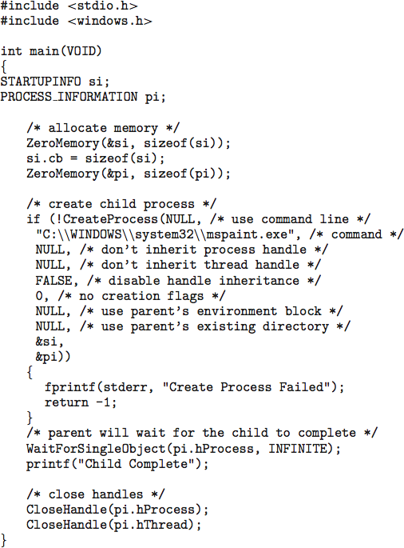
Creating a Separate Process via Windows API

